Slide 1

A/L6986i
Automotive grade / Industrial 38V, 2A Synchronous Isolated Step Down converter with low quiescent current

Slide 2

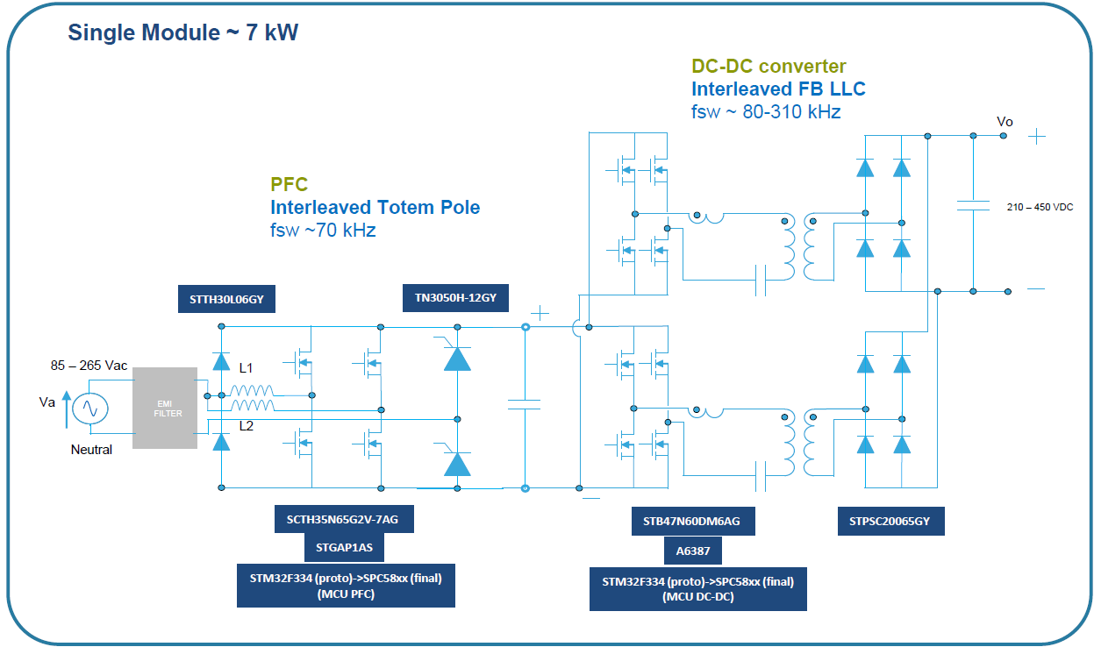
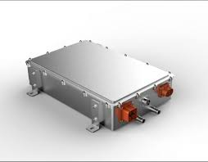
Example of architecture for OBC
From AC-DC to Isolated DC-DC break down
Each SiC to be driven with and Insolated Driver
The supply of an insolated Driver is requested to be isolated as well
Power Schottky rectifier
SiC MOSFET driving circuit
18÷20V
10 – 30V
GND ISO
DC-DC SR
-5V
5V
GND ISO
-5V
HV+
18÷20V
Control unit
Isolated Driver
Isolated Driver

Slide 3
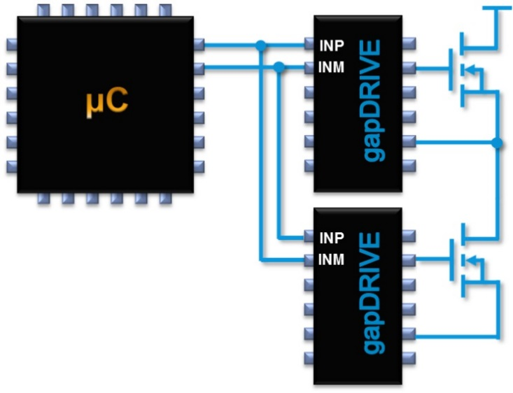
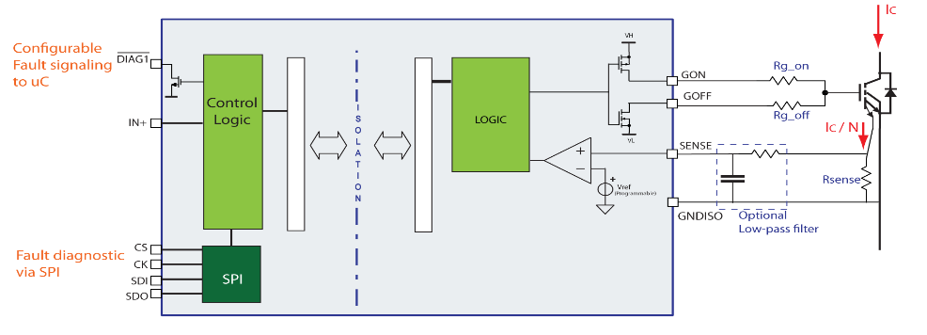
DC DC converter flybuck topology
Two isolated outputs to have positive and negative voltage
+V
GND
A6986I
V_{OUT1,SEC}
-V
N2
5V
V_{CC}
LX
N
V_{IN}
V_{OUT,PRIM}
Gate Driver
V_{REF}
Power Supply galvanic isolation
Gate Driver GALVANIC ISOLATION
Gate Driver

Slide 4
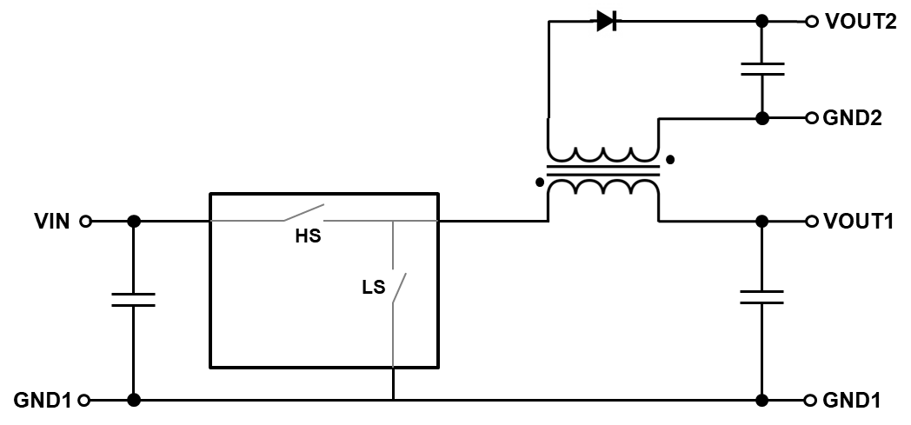
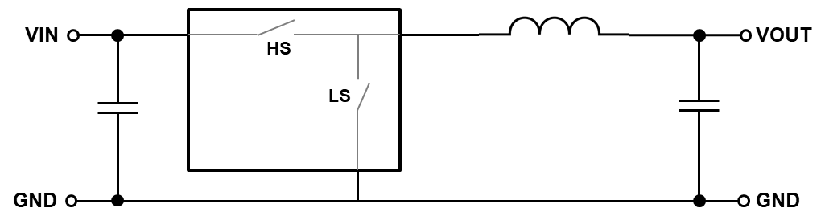
Isolated Buck Converter
Why Isolated Buck Converter?
To achieve galvanic isolation, safety, and enhanced noise immunity, the secondary side is electrically isolated from the primary side in isolated DC/DC converters. This isolation applies to both power stage and control circuitry.
Secondary side
BUCK CONVERTER
ISO-BUCK CONVERTER
Primary side

Slide 5
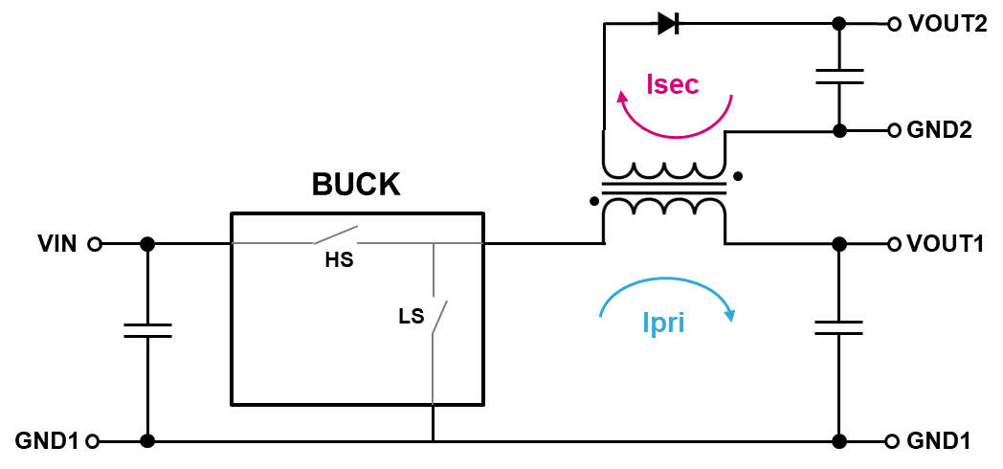
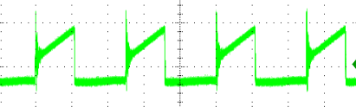
Isolated Buck Converter
Circuital implementation and current waveforms

Slide 6
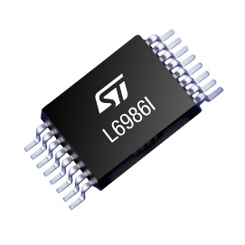
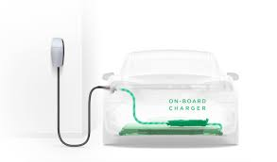

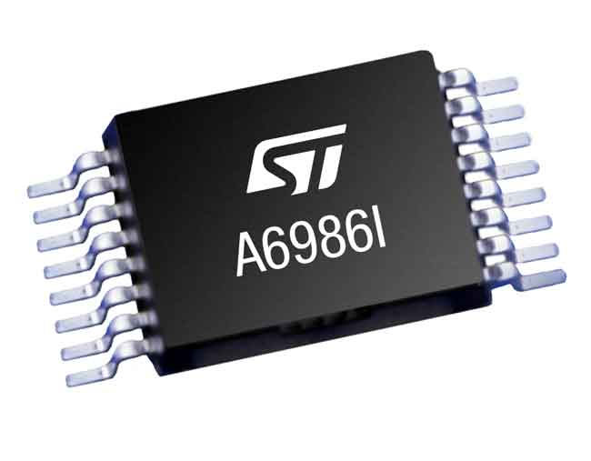
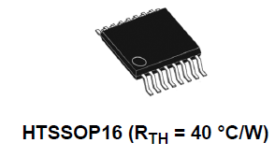
A/L6986i
Low I_{Q} (8 μA), 38 V_{IN} 5W Synchronous Isolated Buck Converter
AEC-Q100 qualified
KEY BENEFITS & FEATURES
Extended negative current limit
  Extended primary side negative current limit to comply to secondary current side with the typical transformer coil ratio
TON sized to mask transition stages
  Masking time filter sized for this isolated buck configuration in order to skip transitory overcurrent peaks during transition stages
High efficiency
  Premium efficiency in all working stages
KEY APPLICATIONS
From 12V & 24V to Isolated Power Supply Buses
Industrial Application
  Motor Drivers
Automotive Application
Automotive isolated IGBT/SiC MOSFET gate drive supply
OBC (On-board charger) for HEV/EV
Electric Traction Systems

Slide 7
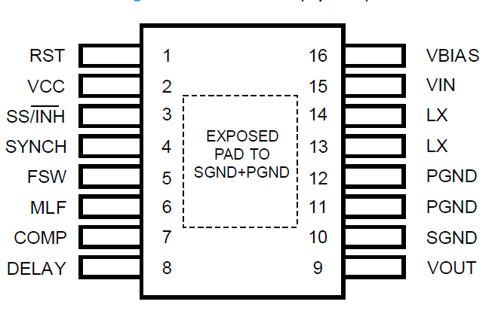
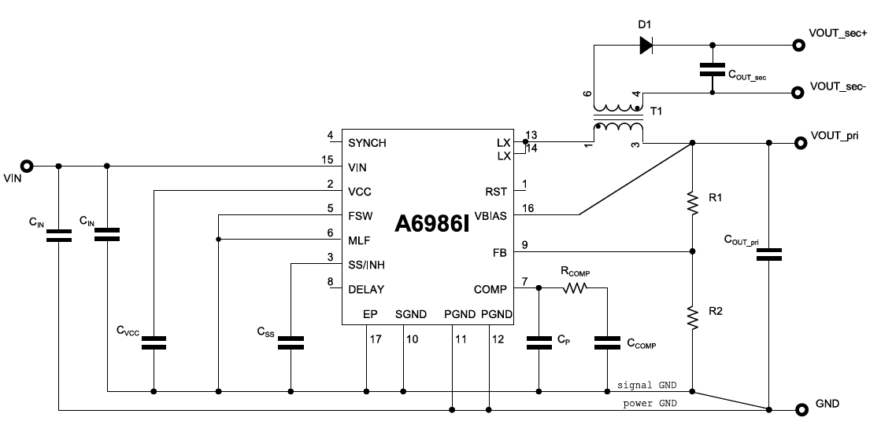
A/L6986i typical application
Pin | Description
RST | The RST open collector output is driven low when the output voltage is out of regulation. The RST is released after an adjustable time DELAY once the primary output voltage is over the active delay threshold.
VCC | Connect a ceramic capacitor (≥ 470 nF) to filter internal voltage reference. This pin supplies the embedded analog circuitry
SS/INH | An open collector stage can disable the device clamping this pin to GND (INH mode). An internal current generator (4 μA typ.) charges the external capacitor to implement the soft-start
SYNCH | The pin features master / slave synchronization
FSW | A pull-up resistor (E24 series only) to VCC or pull down to GND selects the switching frequency. Pin strapping is active only before the soft-start phase to minimize the IC consumption.
MLF | A pull down resistor is used to adjust the RST threshold
COMP | Output of the error amplifier. The designed compensation network is connected at this pin
DELAY | An external capacitor connected to this pin sets the time DELAY to assert the rising edge of the RST open collector after the output voltage is over the reset threshold. If this pin is left floating, RST is like a Power Good
VOUT | Primary output voltage sensing
SGND | Signal Ground
PGND | Power Ground
LX | Switching node
VIN | DC Input Voltage
VBIAS | Typically connected to the regulated primary output voltage, if it does not exceed 6V
E.P | Exposed pad must be connected to SGND, PGND
Pin-out - top view
Application circuit

Slide 8
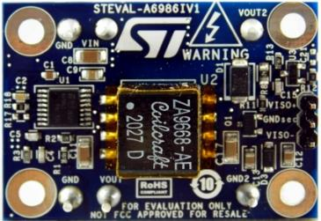
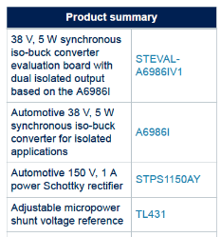
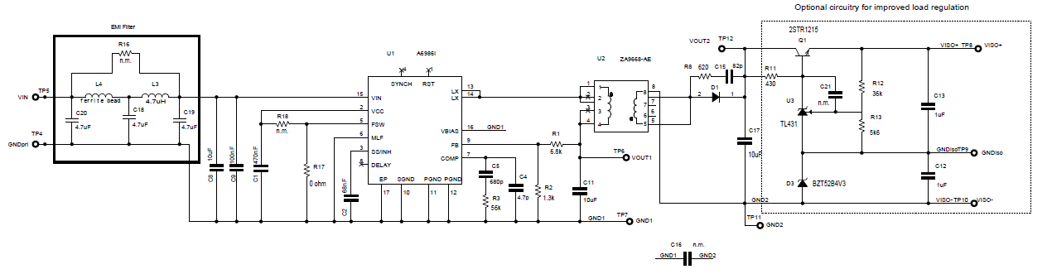
5 W Isolated buck converter evaluation board with dual isolated output
Notes:
ST provides evaluation tools of A6986i.
The evaluation board generates two isolated voltages (positive around 18 V and negative between 4 V and 5 V), especially suitable for supplying IGBT/SiC MOSFET gate driver.
A simple bypass enables the supply of a single isolated voltage.
This is the solution with VREF, BJT and zener.

Slide 9
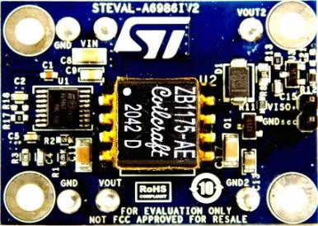
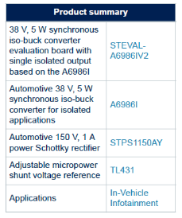
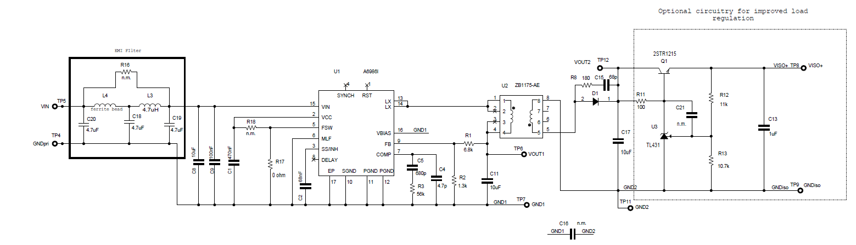
5W isolated buck converter evaluation board with single isolated output
Notes:
This evaluation board generates a single isolated voltage (around 5 V, easily adjustable), especially suitable for applications requiring a single isolated supply.
The post regulation circuit is also embedded but it can be bypassed using dedicated test point to check the performances without the additional circuit.

Slide 10

Thank You

