Slide 1
Integrated Passive Devices (IPD) for RF applications STM32WBA companion chip
DISCRETE & FILTER DIVISION

Slide 2
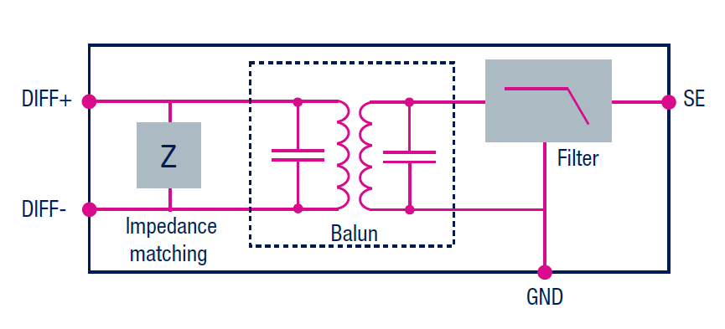
Tuned for high RF integration
ST RF IPD baluns improve system performance & simplify RFIC to antenna matching network complexity
Designed with integrated harmonic filters, they facilitate compliance with major EMC regulations: CCC, FCC, ETSI, ARIB
ST baluns integrate the following functions:
Impedance matching
50 Ω nominal input impedance
Harmonic filter

Slide 3
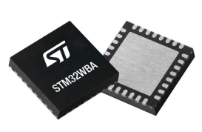
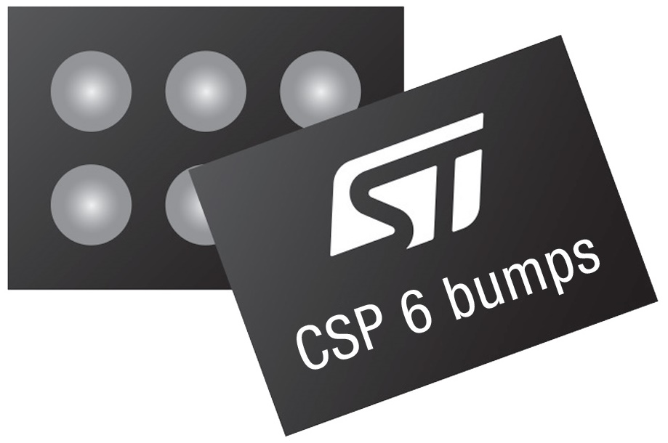
MLPF-WB-04D3
Matched Low-Pass Filter for STM32WBA series
High RF performance in low PCB footprint
Applications
BTLE 5.4, IEEE 802.15.4, Zigbee, Thread, Matter
Alarms, appliances, lighting, Door locks
Smoke detectors, Heating/Cooling systems
Wearable and medical equipment,
Simpler integration
Impedance matching, harmonics filtering and antenna protection
Cost effective
BOM reduction and reliability improvement
Efficiency
Optimizes wireless performance
RF antenna
ST Competitive Edge
STM32WBA
MLPF-WB-04D3
Co-designed, optimized and validated in ST for best RF performances
Glass substrate is less sensitive to process and temperature variation than passive discretes
PCB space reduction with higher RF performance vs discrete solution
Chip Scale Package on glass 6 bumps 1.00 x 1.60 x 0.63 mm
Notes:
The MLPF-WB-04D3 integrates an impedance matching network and harmonics filter.
The matching impedance network has been tailored to maximize the RF performances of STM32WBA5xxx.
The MLPF-WB-04D3 uses STMicroelectronics IPD (Integrated and Passive Device) technology on non-conductive glass substrate which optimizes RF performances.
This is available here in small footprint and low thickness.
Problem solved
For 2.4 GHz wireless applications, the path between RF Antenna and the pins of the RF Transceiver must show a 50 ohm matched impedance.
Also, this impedance has been optimized to guarantee the best receive sensitivity and transmit output power levels. This RF path must limit the frequency harmonics emission as per regulatory administrations like FCC, ETSI or ARIB.
Using discrete RF passive components, the resulting network would be very sensitive to any component variation in temperature. Also, rework would be often needed if it was necessary to recover a 50-ohm impedance match in case the discrete components procurement source is altered.
This discrete network requires a large PCB space occupation.
The MLPF-WB-04D3 provides an optimum impedance to guarantee the best RF performances even with temperature variation, simplifying the RF designer’s constraints.
Features
Monolithic RF solution for 50-ohm Matching and Harmonic Filter
Optimum impedance matched to ST STM32WBA5xxx
Low temperature variation compared with discrete
PCB space reduction
Low profile
Benefits
RF Bill Of Material reduction
High filtering performances to pass FCC, ETSI and ARIB
85% space saving on the PCB
Simplify matching and filtering network complexity

