Slide 1
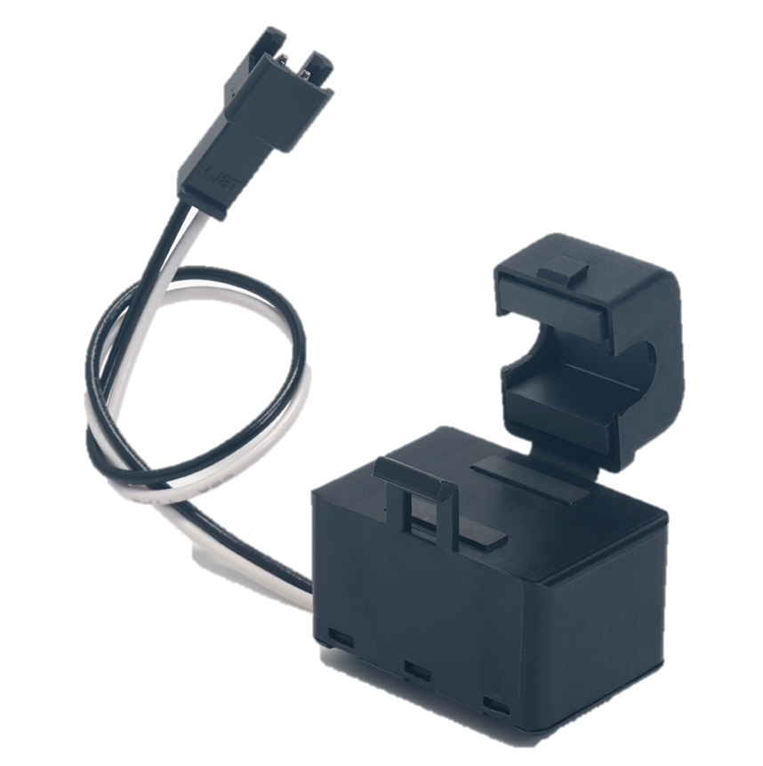
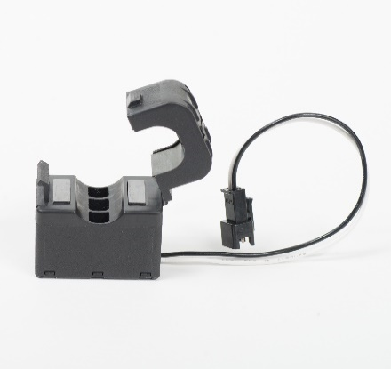
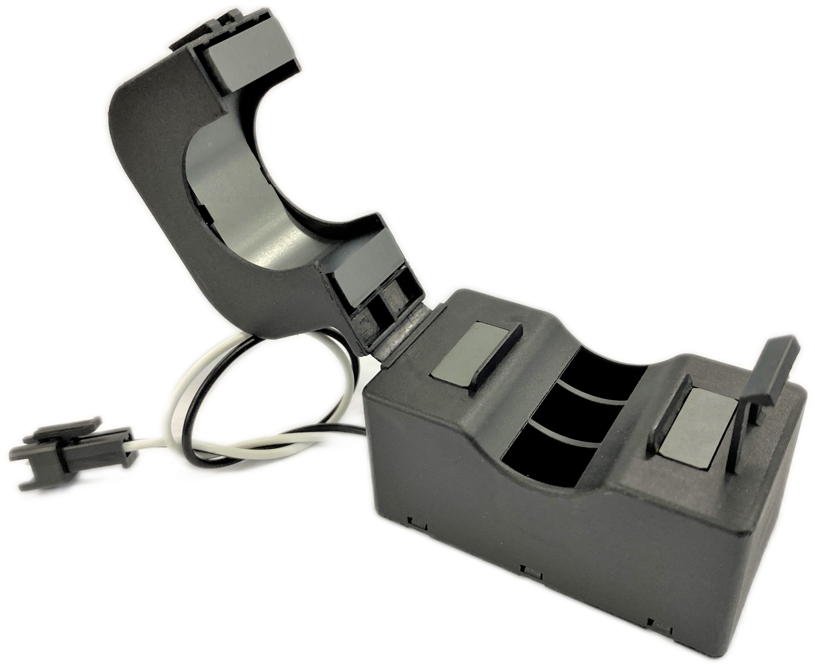
Overview
C/CT Series, High Current AC Sensor, Snap-on Type
C/CT-0306
The C/CT series are clamp-on current sensors that can be used to measure currents in live wires. C/CT-0306 is suitable for currents from 10 up to 30 A.
Electrical Characteristics
Output Voltage
Item | Performance Characteristics
Rated Current | 30 A for C/CT-0306
 | 80 A for C/CT-0810
 | 120 A for C/CT-1216
 | 250 A for C/CT-2524
Applicable Current | 0.1 – 50 A for C/CT-0306
 | 0.1 – 120 A for C/CT-0810
 | 0.1 – 150 A for C/CT-1216
 | 0.1 – 340 A for C/CT-2524
Output Voltage | 100 ±2 mV for C/CT-0306
 | 270 ±5 mV for C/CT-0810
 | 400 ±8 mV for C/CT-1216
 | 1,250 ±25 mV for C/CT-2524
Current Transformation Ratio | 3,000 for C/CT-0306, C/CT-0810 and C/CT-1216
 | 2,000 for C/CT-2524
Output Protection | 7.5 V
Insulation Resistance | 100 MΩ at 500 VDC
Operating Temperature Range | -10ºC to +60ºC
Storage Temperature Range | -20ºC to +75ºC
Benefits
Compact and slim design
Flat temperature characteristics
UL 94 V–0 flame retardant rated case
RoHS compliant
Applications
EMS current measurement
High performance distributions boards
Power conditioners
Power monitoring systems
Inverters
Industrial machinery
C/CT Series
C/CT-0810
C/CT-1216
C/CT-2524
https://www.kemet.com/en/us/sensors

Slide 2
Overview
C/CT Series, High Current AC Sensor, Snap-on Type
C/CT-0810
The C/CT series are clamp-on current sensors that can be used to measure currents in live wires. C/CT-0810 is suitable for currents from 50 up to 80 A.
Electrical Characteristics
Output Voltage
Item | Performance Characteristics
Rated Current | 30 A for C/CT-0306
 | 80 A for C/CT-0810
 | 120 A for C/CT-1216
 | 250 A for C/CT-2524
Applicable Current | 0.1 – 50 A for C/CT-0306
 | 0.1 – 120 A for C/CT-0810
 | 0.1 – 150 A for C/CT-1216
 | 0.1 – 340 A for C/CT-2524
Output Voltage | 100 ±2 mV for C/CT-0306
 | 270 ±5 mV for C/CT-0810
 | 400 ±8 mV for C/CT-1216
 | 1,250 ±25 mV for C/CT-2524
Current Transformation Ratio | 3,000 for C/CT-0810, C/CT-0306 and C/CT-1216
 | 2,000 for C/CT-2524
Output Protection | 7.5 V
Insulation Resistance | 100 MΩ at 500 VDC
Operating Temperature Range | -10ºC to +60ºC
Storage Temperature Range | -20ºC to +75ºC
Benefits
Compact and slim design
Flat temperature characteristics
UL 94 V–0 flame retardant rated case
RoHS compliant
Applications
EMS current measurement
High performance distributions boards
Power conditioners
Power monitoring systems
Inverters
Industrial machinery
C/CT Series
C/CT-0306
C/CT-1216
C/CT-2524
https://www.kemet.com/en/us/sensors

Slide 3
Overview
C/CT Series, High Current AC Sensor, Snap-on Type
C/CT-1216
The C/CT series are clamp-on current sensors that can be used to measure currents in live wires. C/CT-1216 is suitable for currents from 100 up to 120 A.
.
Electrical Characteristics
Output Voltage
Item | Performance Characteristics
Rated Current | 30 A for C/CT-0306
 | 80 A for C/CT-0810
 | 120 A for C/CT-1216
 | 250 A for C/CT-2524
Applicable Current | 0.1 – 50 A for C/CT-0306
 | 0.1 – 120 A for C/CT-0810
 | 0.1 – 150 A for C/CT-1216
 | 0.1 – 340 A for C/CT-2524
Output Voltage | 100 ±2 mV for C/CT-0306
 | 270 ±5 mV for C/CT-0810
 | 400 ±8 mV for C/CT-1216
 | 1,250 ±25 mV for C/CT-2524
Current Transformation Ratio | 3,000 for C/CT-1216, C/CT-0306 and C/CT-0810
 | 2,000 for C/CT-2524
Output Protection | 7.5 V
Insulation Resistance | 100 MΩ at 500 VDC
Operating Temperature Range | -10ºC to +60ºC
Storage Temperature Range | -20ºC to +75ºC
Benefits
Compact and slim design
Flat temperature characteristics
UL 94 V–0 flame retardant rated case
RoHS compliant
Applications
EMS current measurement
High performance distributions boards
Power conditioners
Power monitoring systems
Inverters
Industrial machinery
C/CT Series
C/CT-0306
C/CT-0810
C/CT-2524
https://www.kemet.com/en/us/sensors
©KEMET Corporation. All Rights Reserved.

Slide 4
Overview
C/CT Series, High Current AC Sensor, Snap-on Type
C/CT-2524
The C/CT series are clamp-on current sensors that can be used to measure currents in live wires. C/CT-2524 is suitable for currents from 200 up to 250 A.
.
Electrical Characteristics
Output Voltage
Item | Performance Characteristics
Rated Current | 30 A for C/CT-0306
 | 80 A for C/CT-0810
 | 120 A for C/CT-1216
 | 250 A for C/CT-2524
Applicable Current | 0.1 – 50 A for C/CT-0306
 | 0.1 – 120 A for C/CT-0810
 | 0.1 – 150 A for C/CT-1216
 | 0.1 – 340 A for C/CT-2524
Output Voltage | 100 ±2 mV for C/CT-0306
 | 270 ±5 mV for C/CT-0810
 | 400 ±8 mV for C/CT-1216
 | 1,250 ±25 mV for C/CT-2524
Current Transformation Ratio | 3,000 for C/CT-0306, C/CT-0810 and C/CT-1216
 | 2,000 for C/CT-2524
Output Protection | 7.5 V
Insulation Resistance | 100 MΩ at 500 VDC
Operating Temperature Range | -10ºC to +60ºC
Storage Temperature Range | -20ºC to +75ºC
Benefits
Compact and slim design
Flat temperature characteristics
UL 94 V–0 flame retardant rated case
RoHS compliant
Applications
EMS current measurement
High performance distributions boards
Power conditioners
Power monitoring systems
Inverters
Industrial machinery
C/CT Series
C/CT-0306
C/CT-0810
C/CT-1216
https://www.kemet.com/en/us/sensors
©KEMET Corporation. All Rights Reserved.

