Slide 1
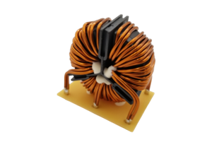
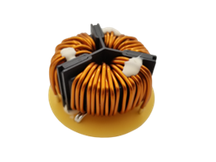
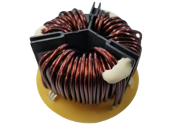
COMMON MODE CHOKES
SCF-X Three-Phase Line Filters
Overview
Electrical Characteristics
The SCF-X series are three-phase common mode chokes suitable for EMC countermeasures in consumer and industrial applications. The core material is made of nanocrystal metal. Two core sizes, φ47 (in vertical or horizontal versions) and φ56 (only in horizontal type), are available for a total of 20 items. The rated voltage is 500 V AC/DC, and the rated current ranges from 20 to 80 A. The optimum specifications can be selected according to various applications.
Two different layouts (vertical / horizontal)
Two different core dimensions (47 / 56 mm)
Rated current range: 20 A to 80 A
Inductance range: 0.34 to 3.21 mH
DCR: 0.55 to 3.52 mΩ
Operating temperature: -40°C to +130°C
SCF47-JV
SCF47-JH
SCF56-JH
Selection Guide
Benefits
Nanocrystalline metal core
Rated voltage up to 500 V AC/DC
High impedance
Operating temperature range from -40℃ to +130℃
UL 94 V–0 flame retardant rated base and cap
Applications
Room air conditioner ・ Package air conditioner
Power conditioner ・ Robot
Inverter-applied industrial equipment
Part Number System
SCF | 47 | X- | 200- | S | 1R8 | B | 011 | JV
Series | Outer Core Diameter | Approval | Rated Current | Phase | Wire Diameter | Windings | Number of Turns | Terminal Base Type
SCF = Nanocrystal core | 47 = 47 mm ø 56 = 56 mm ø | X = Commercial | XXX- = XX.X A Example: 200 = 20 A | S = Three-phase | 1R8 = 1.8 mm | B = Double C = Triple | 011 = 11 turns | JV = Vertical JH = Horizontal
©KEMET Corporation. All Rights Reserved.

